Slide 1
Chapter 2: Operating-System Structures

Slide 2
Game of Differentiation
Multiprogramming & Multitasking
Types of OS:
  Batch OS
  Time Sharing OS
  Distributed OS (multiple central processors)
  Network OS (LAN)
  Real time OS

Slide 3
Spooling
Spooling is an acronym for simultaneous peripheral operations on line. Spooling refers to putting data of various I/O jobs in a buffer. This buffer is a special area in memory or hard disk which is accessible to I/O devices.
Operating system does the following activites related to distributed environment.

Slide 4
OS handles I/O device data spooling as devices have different data access rates.
OS maintains the spooling buffer which provides a waiting station where data can rest while the slower device catches up.
OS maintains parallel computation because of spooling process as a computer can perform I/O in parallel fashion. It becomes possible to have the computer read data from a tape, write data to disk and to write out to a tape printer while it is doing its computing task.

Slide 5
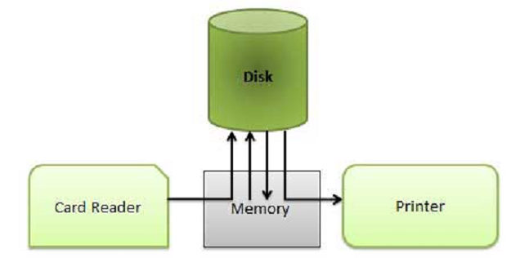
Spooling

Slide 6
Accessing OS services - System Calls
Operating system services (reading or writing files for example) can only be accessed when the CPU is in supervisor mode, but user programs must run in user mode.
The connection can be made through software interrupts.
Specifically ,the interrupt table for software interrupts is initialized by the OS to point to code that changes to supervisor mode and calls appropriate OS routines. (The correct routine either be directly determined by the number of the SW interrupt or by one of the parameters to the system call.)
Such a table and the ISRs must be protected by the OS.

Slide 7
Chapter 2: Operating-System Structures
Operating System Services
User Operating System Interface
System Calls
Types of System Calls
System Programs
Operating System Design and Implementation
Operating System Structure

Slide 8
Objectives
To describe the services an operating system provides to users, processes, and other systems
To discuss the various ways of structuring an operating system
To explain how operating systems are installed and customized and how they boot

Slide 9
Operating System Services
Operating systems provide an environment for execution of programs and services to programs and users
One set of operating-system services provides functions that are helpful to the user:
  User interface - Almost all operating systems have a user interface (UI).
    Varies between Command-Line (CLI), Graphics User Interface (GUI), Batch
  Program execution - The system must be able to load a program into memory and to run that program, end execution, either normally or abnormally (indicating error)
  I/O operations - A running program may require I/O, which may involve a file or an I/O device
  File-system manipulation - The file system is of particular interest. Programs need to read and write files and directories, create and delete them, search them, list file Information, permission management.

Slide 10
Operating System Services (Cont.)
  Communications – Processes may exchange information, on the same computer or between computers over a network
    Communications may be via shared memory or through message passing (packets moved by the OS)
  Error detection – OS needs to be constantly aware of possible errors
    May occur in the CPU and memory hardware, in I/O devices, in user program
    For each type of error, OS should take the appropriate action to ensure correct and consistent computing
    Debugging facilities can greatly enhance the user’s and programmer’s abilities to efficiently use the system

Slide 11
Operating System Services (Cont.)
Another set of OS functions exists for ensuring the efficient operation of the system itself via resource sharing
  Resource allocation - When multiple users or multiple jobs running concurrently, resources must be allocated to each of them
    Many types of resources - Some (such as CPU cycles, main memory, and file storage) may have special allocation code, others (such as I/O devices) may have general request and release code
  Accounting - To keep track of which users use how much and what kinds of computer resources
  Protection and security - The owners of information stored in a multiuser or networked computer system may want to control use of that information, concurrent processes should not interfere with each other
    Protection involves ensuring that all access to system resources is controlled
    Security of the system from outsiders requires user authentication, extends to defending external I/O devices from invalid access attempts
    If a system is to be protected and secure, precautions must be instituted throughout it. A chain is only as strong as its weakest link.

Slide 12

A View of Operating System Services

Slide 13
System Calls
http://www.tuxradar.com/content/how-linux-kernel-works
Programming interface to the services provided by the OS
Typically written in a high-level language (C or C++)
Mostly accessed by programs via a high-level Application Programming Interface (API) rather than direct system call use
Three most common APIs are Win32 API for Windows, POSIX API for POSIX-based systems (including virtually all versions of UNIX, Linux, and Mac OS X), and Java API for the Java virtual machine (JVM)
Why use APIs rather than system calls?
(Note that the system-call names used throughout this text are generic)

Slide 14

Example of System Calls
System call sequence to copy the contents of one file to another file

Slide 15
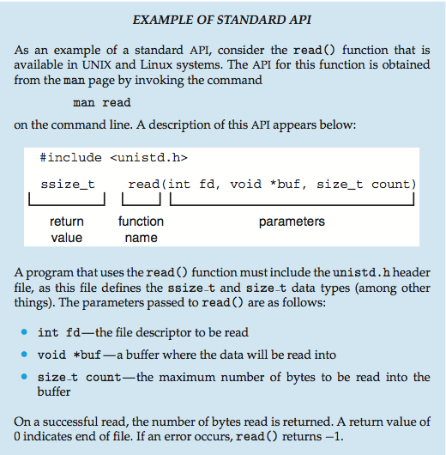
Example of Standard API

Slide 16
System Call Implementation
Typically, a number associated with each system call
  System-call interface maintains a table indexed according to these numbers
The system call interface invokes intended system call in OS kernel and returns status of the system call and any return values
The caller need know nothing about how the system call is implemented
  Just needs to obey API and understand what OS will do as a result call
  Most details of OS interface hidden from programmer by API
    Managed by run-time support library (set of functions built into libraries included with compiler)

Slide 17

API – System Call – OS Relationship

Slide 18

Examples of Windows and
Unix System Calls

Slide 19

Standard C Library Example
C program invoking printf() library call, which calls write() system call

Slide 20

Example: MS-DOS
Single-tasking
Shell invoked when system booted
Simple method to run program
  No process created
Single memory space
Loads program into memory, overwriting all but the kernel
Program exit -> shell reloaded
(a) At system startup (b) running a program

Slide 21

Example: FreeBSD
Unix variant
Multitasking
User login -> invoke user’s choice of shell
Shell executes fork() system call to create process
  Executes exec() to load program into process
  Shell waits for process to terminate or continues with user commands
Process exits with code of 0 – no error or > 0 – error code

Slide 22

Simple Structure
I.e. MS-DOS – written to provide the most functionality in the least space
  Not divided into modules
  Although MS-DOS has some structure, its interfaces and levels of functionality are not well separated

Slide 23
UNIX
UNIX – limited by hardware functionality, the original UNIX operating system had limited structuring. The UNIX OS consists of two separable parts
  Systems programs
  The kernel
    Consists of everything below the system-call interface and above the physical hardware
    Provides the file system, CPU scheduling, memory management, and other operating-system functions; a large number of functions for one level

Slide 24

Traditional UNIX System Structure
Beyond simple but not fully layered

Slide 25

Layered Approach
The operating system is divided into a number of layers (levels), each built on top of lower layers. The bottom layer (layer 0), is the hardware; the highest (layer N) is the user interface.
With modularity, layers are selected such that each uses functions (operations) and services of only lower-level layers

Slide 26
Microkernel System Structure
Moves as much from the kernel into user space
Mach example of microkernel
  Mac OS X kernel (Darwin) partly based on Mach
Communication takes place between user modules using message passing
Benefits:
  Easier to extend a microkernel
  Easier to port the operating system to new architectures
  More reliable (less code is running in kernel mode)
  More secure
Detriments:
  Performance overhead of user space to kernel space communication

Slide 27

Microkernel System Structure

Slide 28
Modules
Most modern operating systems implement loadable kernel modules
  Uses object-oriented approach
  Each core component is separate
  Each talks to the others over known interfaces
  Each is loadable as needed within the kernel
Overall, similar to layers but with more flexible
  Linux, Solaris, etc

Slide 29

Solaris Modular Approach

Slide 30
Hybrid Systems
Most modern operating systems actually not one pure model
  Hybrid combines multiple approaches to address performance, security, usability needs
  Linux and Solaris kernels in kernel address space, so monolithic, plus modular for dynamic loading of functionality
  Windows mostly monolithic, plus microkernel for different subsystem personalities
Apple Mac OS X hybrid, layered, Aqua UI plus Cocoa programming environment
  Below is kernel consisting of Mach microkernel and BSD Unix parts, plus I/O kit and dynamically loadable modules (called kernel extensions)

Slide 31
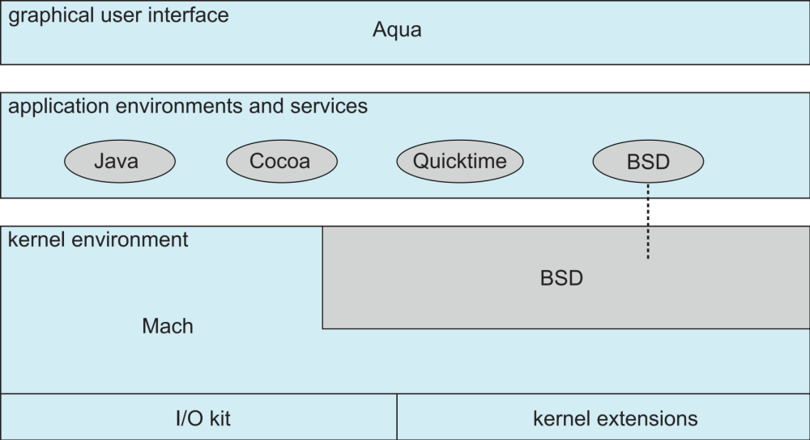
Mac OS X Structure

Slide 32
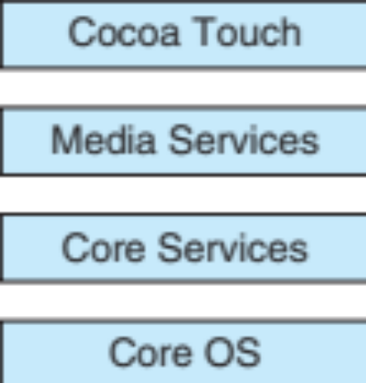
iOS
Apple mobile OS for iPhone, iPad
  Structured on Mac OS X, added functionality
  Does not run OS X applications natively
    Also runs on different CPU architecture (ARM vs. Intel)
  Cocoa Touch Objective-C API for developing apps
  Media services layer for graphics, audio, video
  Core services provides cloud computing, databases
  Core operating system, based on Mac OS X kernel

Slide 33
Android
Developed by Open Handset Alliance (mostly Google)
  Open Source
Similar stack to IOS
Based on Linux kernel but modified
  Provides process, memory, device-driver management
  Adds power management
Runtime environment includes core set of libraries and Dalvik virtual machine
  Apps developed in Java plus Android API
    Java class files compiled to Java bytecode then translated to executable than runs in Dalvik VM
Libraries include frameworks for web browser (webkit), database (SQLite), multimedia, smaller libc

Slide 34
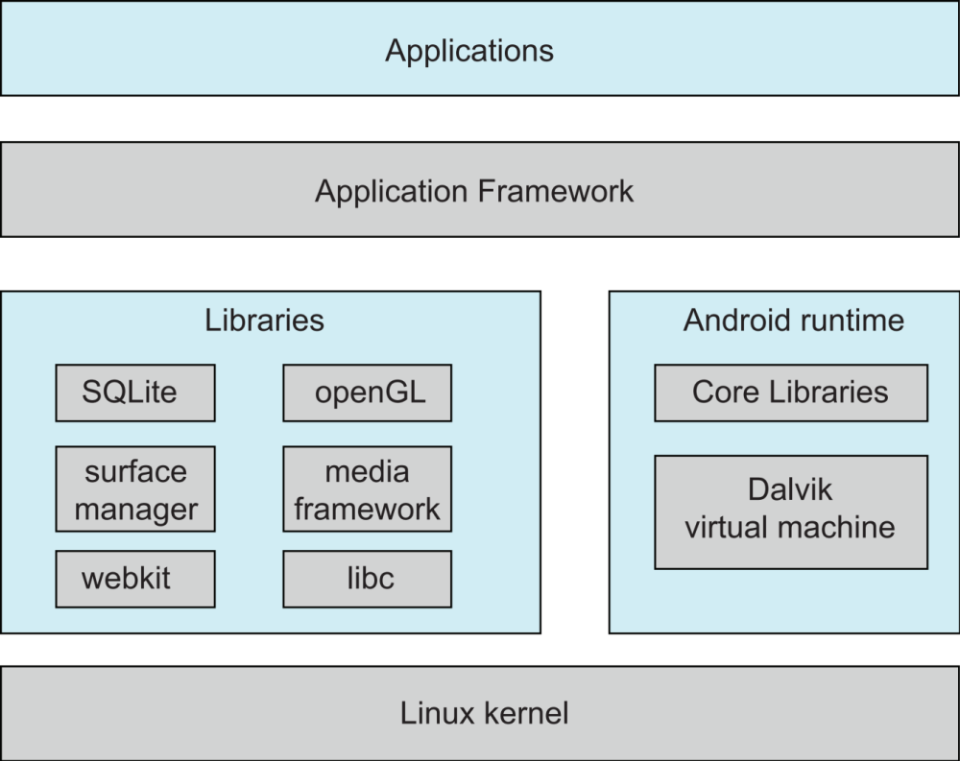
Android Architecture

Slide 35
End of Chapter 2

